Slide 1
Discussion 06:
Object-Oriented Programming
Jennifer Tsui
jentsui.github.io

Slide 2
Announcements
Conceptual OH Fridays 1-2 in 531 Cory
Hw due tomorrow
Ants due Thurs. March 14th
print(“DEBUG:”, x)
Sign up for 1-on-1 tutoring

Slide 3
OOP terms
Term | Explanation | Example
class | a template for creating objects | a template for CS 61A students
instance | a single object created from a class | a single student
instance attribute | a property of an object, specific to an instance | a student’s name, year, major
class attribute | a property of an object, shared by all instances of a class | the students’ instructor
method | a function in a class that all instances of the class can call | attending lecture, visiting office hours

Slide 4
Dot notation: <expression>.<name>
name is found in class: we’re done!
expression is a class
look up name within the class
name is not found in class
name is found in instance: we’re done!
expression is an instance
look up name within instance
look up name in class!!!
name is not found in instance

Slide 5
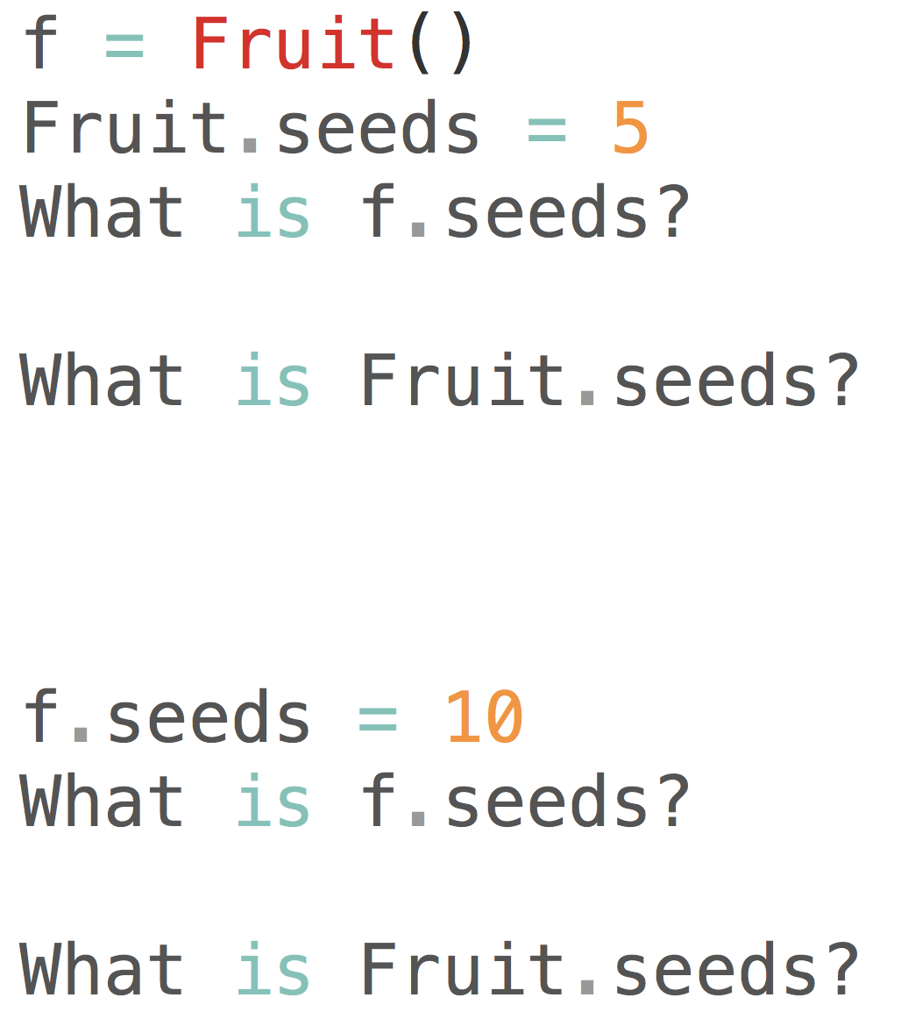
WWPD? Say we have a Fruit class...

Slide 6
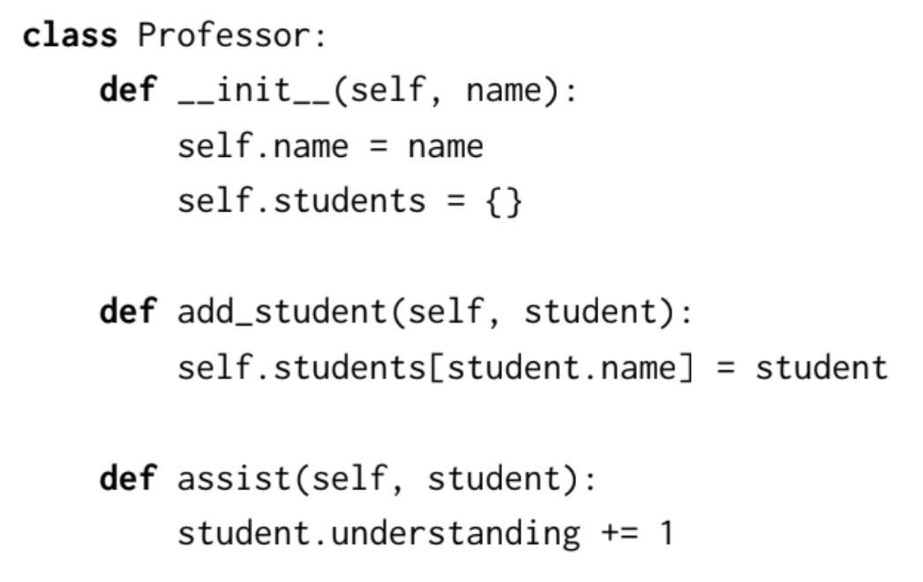
Anatomy of a class definition (page 2)
class name
constructor
initialize instance attributes
method definitions

Slide 7
Invoking methods
Methods are invoked (called) using dot notation.
An instance must be passed in as the first argument to a method.
This can happen in one of two ways:
Call the method on the class, explicitly passing in an instance: | Call the method on an instance, implicitly passing in that instance:
Instructor.assist(garcia, student1) | garcia.assist(student2)
Here, in either case, the parameter self is bound to the object referenced by the name garcia, and the parameter topic is bound to the string “OOP”

Slide 8
Invoking methods
Methods of a class are invoked using dot notation.
<obj_expr>.<method_name>(<operand_1>, …)
To evaluate:
Evaluate <obj_expr> using dot notation rules.
Look up <method_name> using dot notation rules.
Open a new frame for this method call.
If <obj_expr> evaluates to a class, bind <self> to the value of <operand_1>.
If <obj_expr> evaluates to an instance, bind <self> to that instance.
Bind the rest of the arguments to the rest of the parameters of the method.
Execute the body of the method.

Slide 9
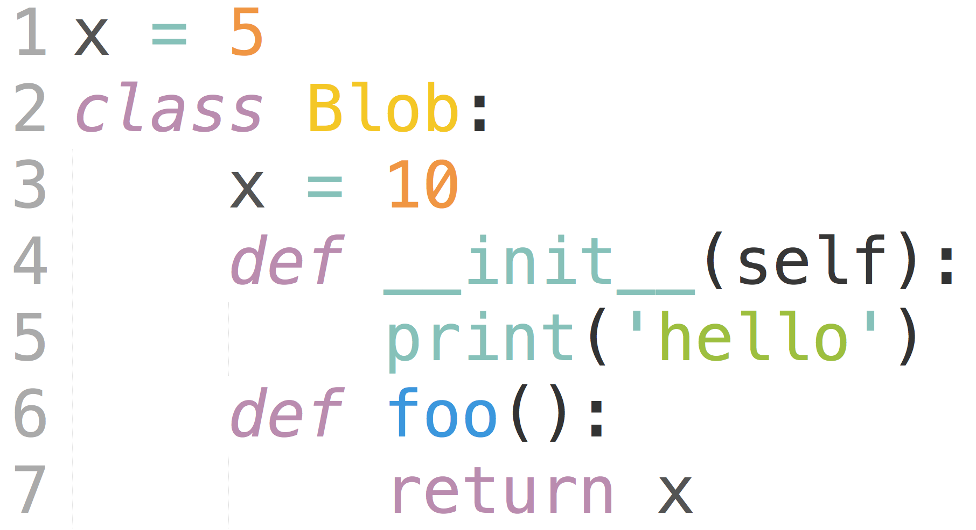
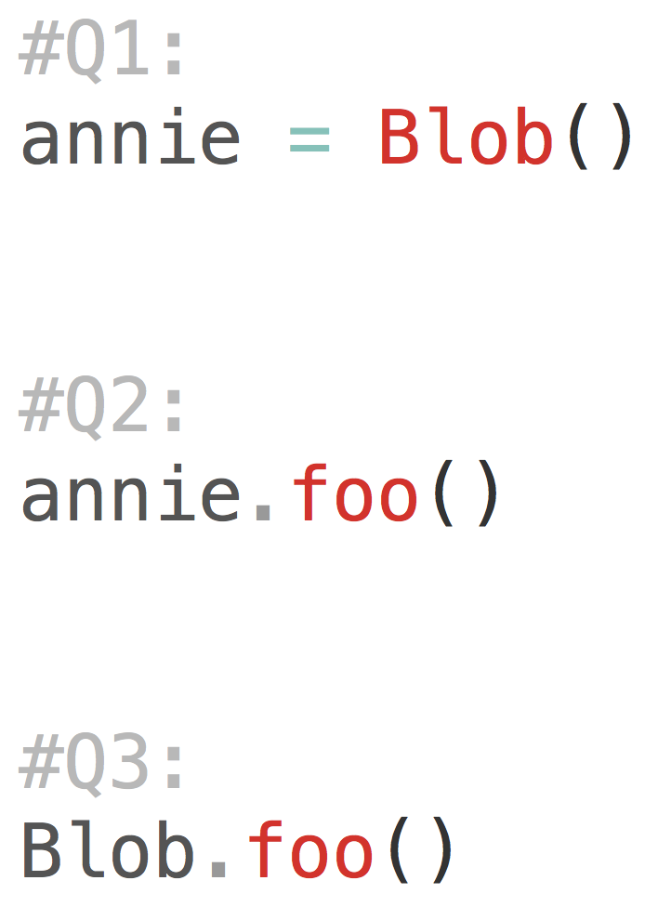
Edge Cases: WWPD?

Slide 10
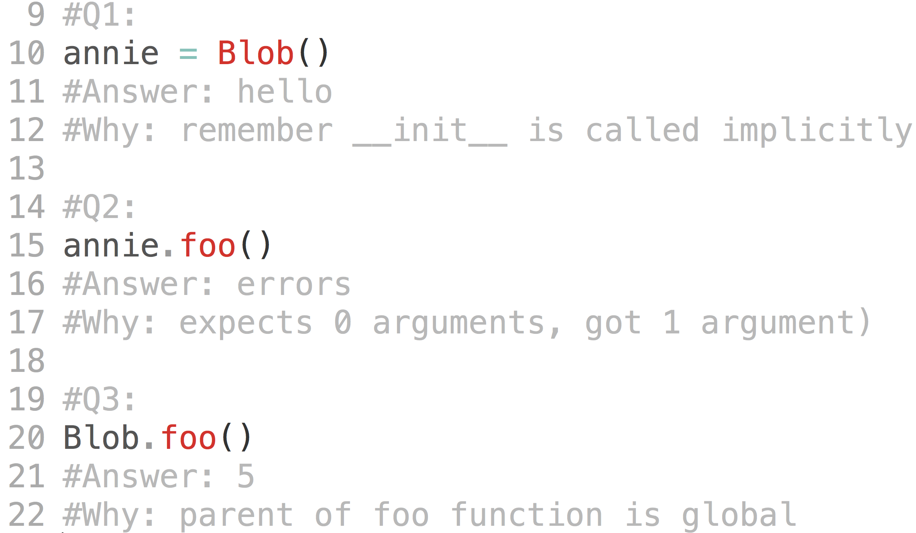
Edge Cases

Slide 11
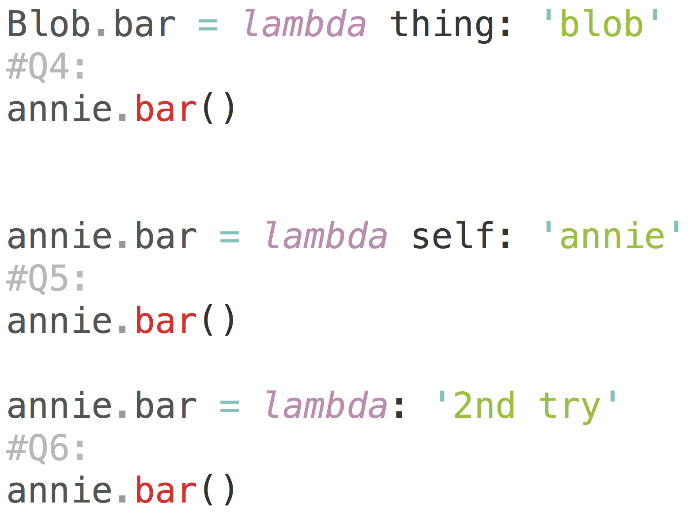
More Edge Cases

Slide 12
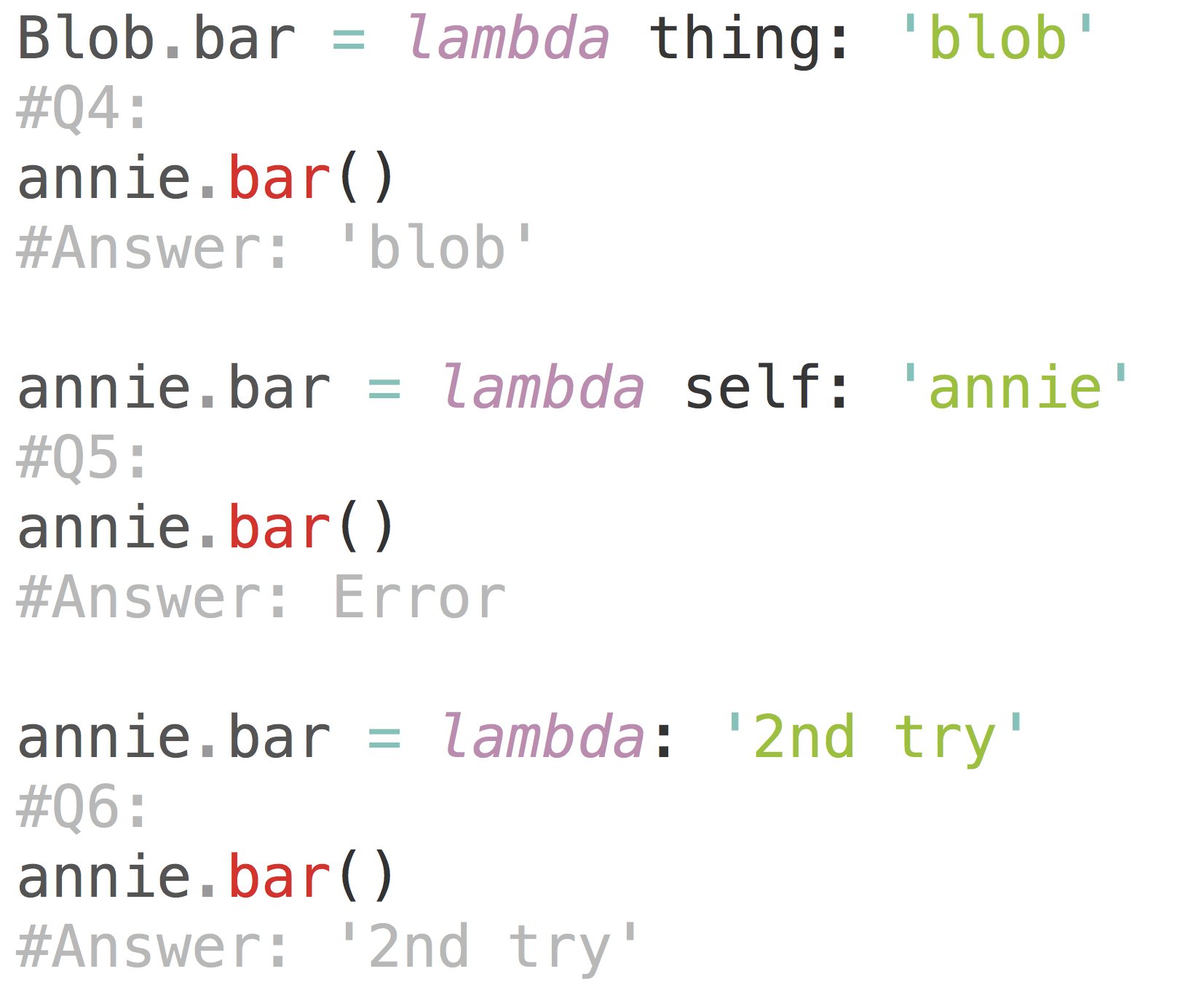
Rule: When do we pass in the instance as the first argument implicitly?
2 conditions:
LHS of dot notation is an instance
RHS of dot notation is a method found in the class

Slide 13
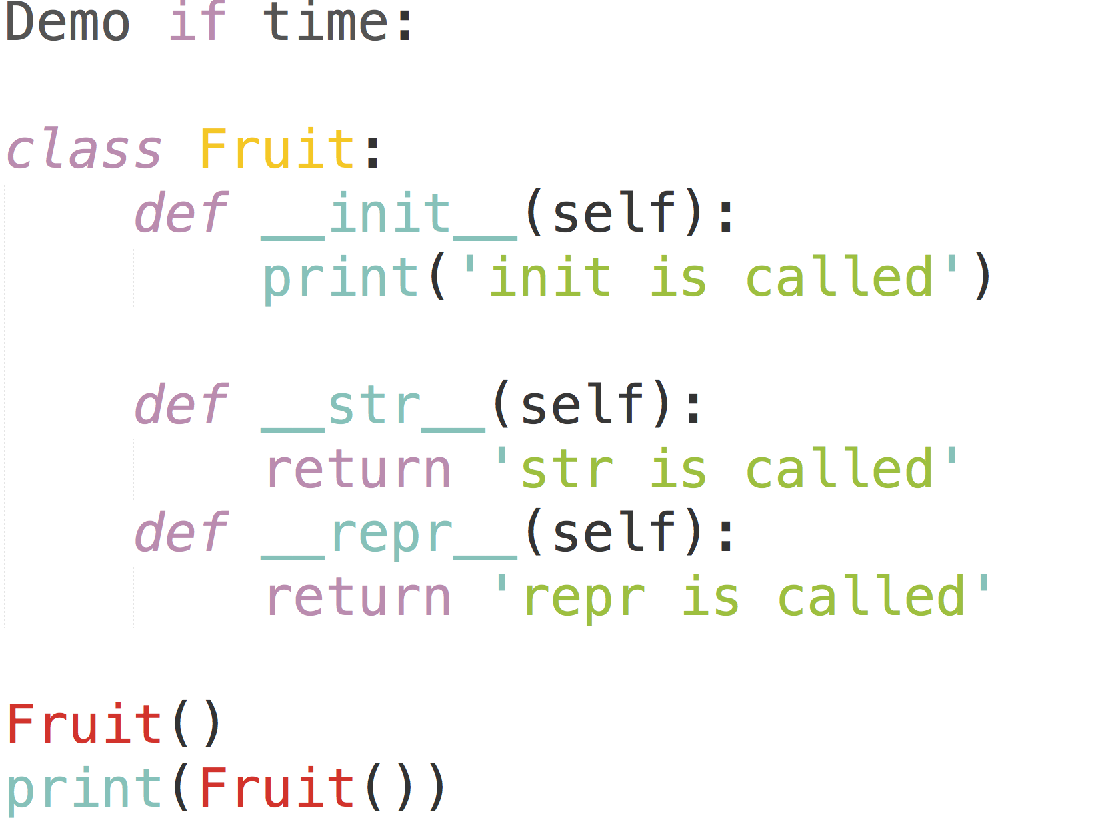
str/repr

Slide 14
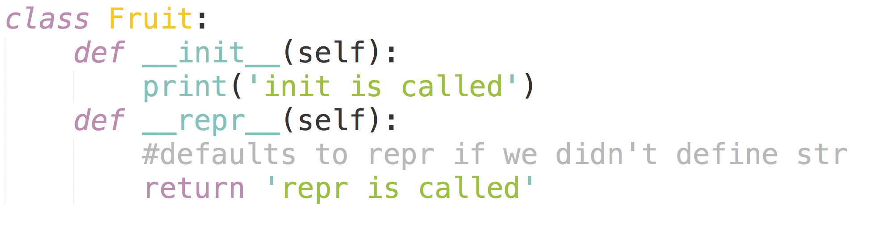
str/repr

Slide 15
Q1.2: Email
Email class, __init__ method:
How do you initialize an instance variable?
Server class, register_client method:
Access the clients dictionary (an instance attribute) of the given client
Add a new key-value pair to a dictionary
Server class, send method:
Get name of client from email
Get client object from clients dictionary
Use the client’s receive method
Client class, compose method:
Create a new email object
The email’s sender is the current client
Use our server’s send method
Client class, receive method:
Access our client’s inbox
Add email to inbox (a list of emails)

Slide 16
Inheritance

Slide 17
Hierarchy of objects
In real life, we can put objects into a hierarchy, where some objects are more specific versions of other objects.
Represents is-a relationships (i.e. a cat is a pet)
Does not represent has-a relationships (i.e. a cat has a tail)
If we had a class describing the tail of a cat, we wouldn’t make it a subclass of cat
pet
dog
cat
labrador
poodle
calico
tabby

Slide 18
Dot notation: <expression>.<name>
name is found in class: we’re done!
expression is a class
look up name within the class
look up name in superclass!!!
name is not found in class

Slide 19
Dot notation: <expression>.<name>
name is found in class: we’re done!
expression is a class
look up name within the class
look up name in superclass!!!
name is not found in class
name is found in instance: we’re done!
expression is an instance
look up name within instance
look up name in class!!!
name is not found in instance

Slide 20
Dot Notation
With the introduction of superclasses, we need to update our dot notation lookup rules.
<expression>.<name>
To evaluate:
Evaluate <expression>. It should evaluate to a class or an instance of a class.
If <expression> is itself a “dot” expression, you must recursively do this type of lookup!
If <expression> evaluates to a class, look up the <name> within the class.
If <name> is not found in the class, look it up in the chain of superclasses.
If <expression> evaluates to an instance, look up the <name> within the instance.
If <name> is not found in the instance, look in the instance’s class.
If <name> is not found in the class, look it up in the chain of superclasses.
Notes:
credits to tammy nguyen, spring 2018! tammy is great we love tammy!

Slide 21
Cat vs. Dog (page 6)
class Dog(Object):
def __init__(self, name, owner):
self.is_alive = True
self.name = name
self.owner = owner
def eat(self, thing):
print(self.name + "
ate a " + str(thing) + "!")
def talk(self):
print(self.name +
" says woof!")
class Cat(Object):
def __init__(self, name, owner, lives=9):
self.is_alive = True
self.name = name
self.owner = owner
self.lives = lives
def eat(self, thing):
print(self.name + " ate a " +
str(thing) + "!")
def talk(self):
print(self.name +
" says meow!")

Slide 22
Inheritance
class Dog(Pet):
def talk(self):
print(self.name +
" says woof!")
class Pet(object):
def __init__(self, name, owner):
self.is_alive = True
self.name = name
self.owner = owner
def eat(self, thing):
print(self.name + " ate a " +
str(thing) + "!")
def talk(self):
print(self.name)

Slide 23
Inheritance: Reuse code!
class Pet(object):
def __init__(self, name, owner):
self.is_alive = True
self.name = name
self.owner = owner
def eat(self, thing):
print(self.name + " ate a " +
str(thing) + "!")
def talk(self):
print(self.name)
superclass: Pet
subclass: Dog
subclass can inherit and override methods of superclass
Let’s create an instance of Dog:
fido = Dog() #implicitly calls __init__
When we can’t find a variable in the subclass, we look up to its superclass
Variable lookup:
instance => class => superclass
class Dog(Pet):
def talk(self):
print(self.name +
" says woof!")

